Slide 1
Chapter One
introduction to Data Communications
By
Michael Mulongo

Slide 2
Students will be able to:
Understand basic functions on which modern communication systems are built
Know how packets find their way through the Internet, and how congestion is avoided
Know how wireless communication works
Develop programs that efficiently communicate over a network
Have the required basis for working in this area

Slide 3
DATA COMMUNICATION
When we communicate, we are sharing information.
This sharing can be local or remote. Between individuals, local communication usually occurs face to face, while remote communication takes place over distance.
Communications”
With an ’s’ at the end!
“The branch of technology concerned with the representation, transfer, interpretation, and processing of data among persons, places, and machines also known as information systems.”
http://www.wikipedia.org
Telecommunication: means Communication at a distance

Slide 4
Data communications
Exchange of data between two devices via some form of transmission medium such as a wire cable.
For data communications to occur, the communicating devices must be part of a communication system made up of a combination of hardware (physical equipment) and software (programs).
The effectiveness of a data communications system depends on four fundamental characteristics
Delivery, accuracy, timeliness, and jitter.

Slide 5
Data communication
Encoding – this is the process through which information from the sending device is converted into signals which the communication medium can carry.
Transmission – this is the process through which the signals are broad cast/ sent out through the medium to the receiving device.
Decoding – this is the process through which the signals are converted back into the information in its original form in the receiving device.
Teleprocessing – this refers to access and modification of computer files located elsewhere.
Downloading – to transfer a file from another computer to your computer.
Uploading – means to transfer a file from your computer to another computer.
Throughput – refers to the rate how much data is moved during a certain amount of time.
Bandwidth – the amount of signals that can travel over a communication channel. The higher the bandwidth, the more data and information the channel can transmit.
Data encryption – this is the process of converting data into coded form (cypher text) to prevent it from being read or understood by unauthorized people. Encrypted data is difficult to decode with a secret key.

Slide 6
What is a Network
Course Content
Set of devices communicating with each other. Could be a CPU, monitor and other peripheral devices connected (and exchanging data) to each other. Could be a group of people …. A network of friends.
Network criteria
Network criteria refer to the set of standards and requirements that are used to evaluate and design a computer network. These criteria help ensure the efficiency, reliability, and security of the network.
A network must be able to meet a certain number of criteria. The most important of these are

Slide 7
Network criteria
Performance ( Transit /response time, Throughput, delay)
Bandwidth. Adequate bandwidth is essential for efficient data transfer. It is the maximum rate at which data can be transmitted over a network.
Latency. Low latency is crucial for real-time applications. It represents the time delay between the initiation and completion of a data transmission.
Throughput. Throughput measures the actual amount of data that can be transmitted successfully over the network in a given time period.
Reliability: (Network reliability is measured by the frequency of failure, the time it takes a link to recover from a failure, and the network's robustness in a catastrophe)
Availability. A reliable network should be available for use when needed. This involves minimizing downtime and ensuring that the network is accessible.

Slide 8
Network criteria
Security. Network security issues include protecting data from unauthorized access, protecting data from damage and development, and implementing policies and procedures for recovery from breaches and data losses.
Access control. Implementing measures to control and restrict access to the network resources based on user roles and privileges.
Data encryption. Using encryption to protect sensitive data during transmission.
Firewalls and Intrusion Detection Systems. Deploying firewalls and IDS to monitor and control network traffic, identifying and preventing unauthorized access.
Scalability.
Expandability. The network should be able to accommodate additional devices or users without a significant decrease in performance.
Flexibility. The ability to adapt and grow as the organization's needs change, supporting new technologies or services.

Slide 9
Network criteria
Manageability.
Having tools and protocols in place for monitoring and managing the network efficiently.
Ensuring that the network is well-documented, and changes are tracked and controlled.
Cost effectiveness.
Evaluating the overall costs associated with acquiring, implementing, and maintaining the network infrastructure. Assessing the benefits of the network in relation to its costs.
Compatibility and interoperability.
Adhering to industry standards to ensure compatibility with different devices and systems.
Ensuring that different components and systems can work together seamlessly.

Slide 10
Network criteria
Ease of use.
Providing interfaces that are intuitive and easy for users to navigate.
Ensuring that users are adequately trained to use the network resources effectively.

Slide 11
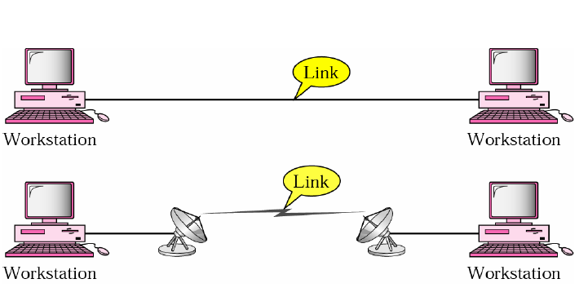
Point to point Connections
Point-to-Point A point-to-point connection provides a dedicated link between two devices. The entire capacity of the link is reserved for transmission between those two devices.
Most point-to-point connections use an actual length of wire or cable to connect the two ends, but other options, such as microwave or satellite links, are also possible. When you change television channels by infrared remote control, you are establishing a point-to-point connection between the remote control and the television's control system

Slide 12
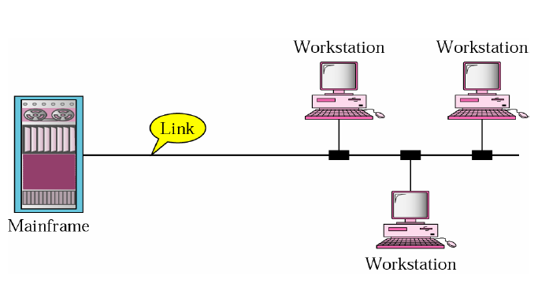
Multi point Connections
Course Content
Multipoint A multipoint (also called multidrop) connection is one in which more than two specific devices share a single link.
In a multipoint environment, the capacity of the channel is shared, either spatially or temporally.
If several devices can use the link simultaneously, it is a spatially shared
connection. If users must take turns. it is a timeshared connection.

Slide 13
Types of Data Communications
Data flow(Transmission) type is the direction of the flow of information between two communication devices. It is also called Data Communication or Directional Mode.
It specifies the direction of the flow of information from one place to another in a computer network. They are classified as; simplex, duplex and half-duplex.
Simplex is the data transmission mode in which the data can flow only in one direction. The communication is unidirectional.
Duplex is the data transmission mode in which the data can flow in both directions at the same time. It is bi-directional in nature.
Half duplex is the data transmission mode in which the data can flow in both directions but one direction at a time.

Slide 14
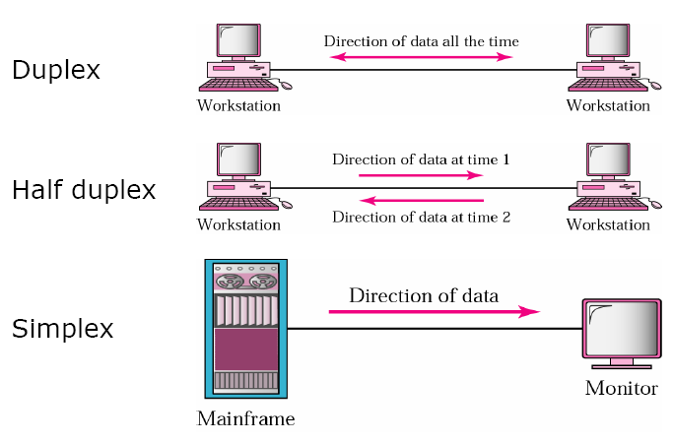
DATA FLOW/ CONNECTIVITY TYPES

Slide 15
Types of data communications Simplex transmission
In this mode, a sender can only send data but can not receive it. Similarly, a receiver can only receive data but can not send it. Examples include, Radio and TV transmission, keyboard, mouse etc.
Advantages
It utilizes the full capacity of the communication channel during data transmission.
It has the least or no data traffic issues as data flows only in one direction.
Disadvantages
It is unidirectional in nature having no inter-communication between devices.
There is no mechanism for information to be transmitted back to the sender (No mechanism for acknowledgement).

Slide 16
Half duplex
This type of data transmission mode can be used in cases where there is no need for communication in both directions at the same time. In such cases, the data needs to be transmitted again by the receiver. For example, Walkie-Talkie, Internet Browsers.
Advantages.
it facilitates the optimum use of the communication channel.
It provides two way communication.
Disadvantages
The two way communication can not be established simultaneously at the same time.
Delay in transmission may occur as only one way communication can be possible at a time.

Slide 17
Full Duplex
It is two way communication in which both stations can transmit and receive the data simultaneously. For example, a Telephone Network, in which both persons can talk and listen to each other simultaneously.
Advantages
The two way communication can be carried out simultaneously in both directions.
It is the fastest mode of communication between devices.
Disadvantages
There is no dedicated path for data transfer. This is because the capacity of the communication channel is divided into two parts.
It has improper channel bandwidth utilization as there exist two separate paths for two communicating devices.

Slide 18
Transmission modes
They are three;
Unicast
Broadcast
Multicast
The cast term signifies some data is being transmitted to the recipient(s) from the client(s) side over the communication channel that helps them to communicate.
NOTE
Multiplex transmission allows several types of signals to be carried at once through the same line. E.g. video calls.

Slide 19
Unicast
This is a communication where a message is sent from one sender to one receiver. Data is sent to a single recipient.
It uses a unique destination address.
There is guaranteed delivery.
It generates the least amount of network traffic.
It is more secure because data is sent to a specific recipient.
It has low latency
Examples
Email, file transfer.

Slide 20
Broadcast
This is a communication where a message is sent from one sender to many receivers. Data is sent to all recipients in a network.
It uses special broadcast address.
Not all devices may be interested in the data.
It generates a high network traffic.
It is less secure because data is sent to all devices in the network.
It has a high bandwidth.
It has a high latency.
It has limited broadcasting.
Examples
DHCP requests and ARP requests.

Slide 21
Multicast
This is a communication where a message is sent from one/more senders to one/more recipients. Multicast lets servers direct single copies of data streams that are then simulated and routed to hosts that request it.
It sends data from one device to multiple devices.
It works on star, mesh, tree and hybrid topology.
It does not scale well across large networks.
It has efficient utilization of bandwidth.
Network traffic is low.
IP multicast requires the support of some other protocols like IGMP(Internet Group Management Protocol).
Example
Video streaming, online gaming.

Slide 22
Communication model
A communication model is used to exchange data between two parties. For example between a computer, server and telephone.

Slide 23
Components of a Communication System (communication model).
Rule 1
Rule 2
Rule n
Rule 1
Rule 2
Rule n
Message
Sender
Medium
Receiver
1

Slide 24
The Communication Model
Message. Is the information (data) to be communicated. (text, numbers, pictures, audio, and video).
Sender. The device that sends the data message. It can be a computer. (workstation, telephone handset, video camera, and so on).
Receiver. The device that receives the message. It can be a computer, workstation, telephone handset, television, etc.
Transmission medium. Is the physical path by which a message travels from sender to receiver. Twisted-pair wire, coaxial cable, fiber-optic cable, and radio waves.
Protocol. Is a set of rules that govern data communications. It represents an agreement between the communicating devices. Without a protocol, two devices may be connected but not communicating, just as a person speaking French cannot be understood by a person who speaks only Japanese.

Slide 25
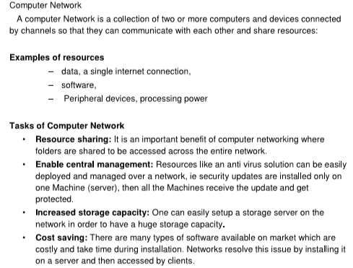
Computer network tasks.

Slide 26
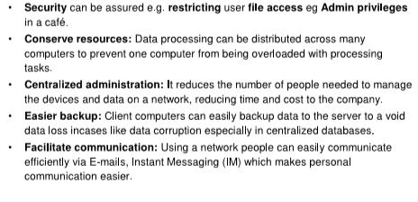
Computer network tasks

Slide 27
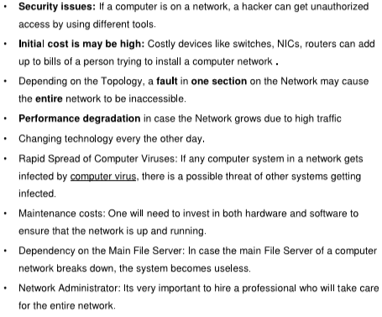
Challenges of computer networking
.

Slide 28
Data transmission and transmission media.
Data transmission is the transfer of data from one point to another. This is the movement of data in form of bits between two or more digital devices.
Any transmissions sent during these communications can be categorized by a number of characteristics including the signal type, transmission mode, transmission direction and transmission rate.
Signal Type – There are two types of signals namely:
Analog signals
Digital signals.

Slide 29
Analog signals
An analog signal uses variations which are represented by a continuous waveform to convey information.
It is particularly useful for wave data like sound waves.
Analog signals are used by the phone lines and sound speakers.

Slide 30
Digital signals
A digital signal is a series of discrete (discontinuous) bits which are simply the presence or absence of an electric pulse.
The state of being on or off represents the binary digit of 1 or 0, respectively.
Advantages of digital signals.
They can be copied exactly without any loss of quality.
They can be further processed by the computer.

Slide 31
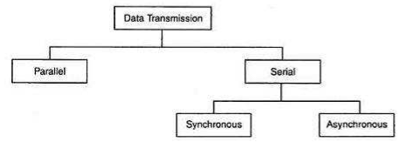
Types of data transmission
.

Slide 32
Parallel Transmission
This is where all the bits of data are transmitted simultaneously on separate communication lines.
It is used for short distance communication.
Advantage
It is a speedy way of transmitting data. This is because multiple bits are transmitted simultaneously with a single clock pulse
Disadvantage
It is costly because it requires extra lines to transmit many bits at the same time.

Slide 33
Serial Transmission
This is where various bits of data are transmitted one at a time. This uses a single data line to transmit one bit at a time using a fixed time interval for each bit.
Advantages
It can be used for long distance communications.
It has reduced costs since it uses a single communication line.
Disadvantage
Use of conversion devices at source and destination end may lead to increase in overall transmission cost.
This method is slower as compared to parallel transmission because bits are transmitted serially one after the other.

Slide 34
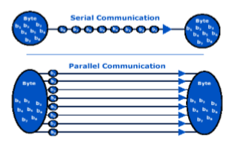
Serial and Parallel Communications

Slide 35
Types of serial Transmission
There are two types:
Synchronous and
Asynchronous transmissions
These two transmissions use ‘Bit synchronization’.
Bit synchronization is a function that is required to determine when the beginning and end of data transmission occurs. It helps the receiving computer to know when data begin and end during a transmission. Therefore, it provides timing control.

Slide 36
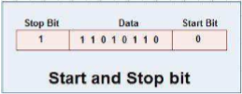
Asynchronous transmission
This transmits one byte at a time over a line at random intervals
A start bit is for marking the beginning of the byte, a stop bit is for marking the end of the byte and a parity bit for error checking.
A start bit alerts the receiver to the arrival of new group of bits. A start bit usually 0 is added to the beginning of each byte.
A stop bit lets the receiver know that the byte is finished, one or more additional bits are appended to the end of the byte.

Slide 37
Advantages of asynchronous transmission.
It is cheaper than synchronous transmission. It is better for short lines because line cost would be low and idle time will not be expensive.
In this mode, each individual character is complete in itself. This means, if a character is corrupted, its successor and predecessor characters will not be affected.
It is possible to transmit signals from sources having different bit rates.
It starts transmission as soon as the data byte to be transmitted becomes available.
This mode of transmission is easy to implement.

Slide 38
Disadvantages of asynchronous transmission
It is less efficient and slower than synchronous transmission due to the overhead of extra bits and insertion of gaps into bit stream.
It successful transmission depends on the recognition of the start bits. These bits can be missed or corrupted.

Slide 39
Synchronous Transmission
This transmits groups of bytes simultaneously at regular intervals. It require more complicated and expensive communication devices but it provides much higher speeds and greater accuracy than asynchronous transmission.

Slide 40
Advantage of synchronous transmission
It is faster as compared to asynchronous transmission. This is because there are no extra bits (start and stop bit) and also there is no gap between the individual data bytes.
Disadvantages
It is costly as compared to asynchronous method. This is due to the fact that it requires local buffer storage at the two ends of lines to assemble blocks and it also requires accurately synchronized clocks at both ends.
The sender and receiver have to operate at the same clock frequency. This makes the system complicated because it requires proper synchronization.

Slide 41
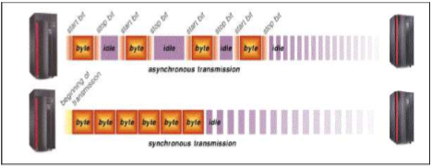

Slide 42
Data transmission media
Data transmission media refer to the media through which data can be carried from a source to a destination. Data is transmitted from one device to another through electromagnetic signals.
The different categories of transmission media include;
Guided(wired) media –wires, cables
unguided(wireless) media – wireless transmission e.g. radio waves, microwave, infrared, sound, sonar.

Slide 43
Factors to consider when choosing a transmission medium
Transmission distance to be covered.
Desired bit rate/ bandwidth
Cost of transmission media, installation, etc.
Installation and maintenance.
Interference and Attenuation.
Security of the transmission media.
Environmental conditions such as temperature, humidity etc.
Scalability.
Standards and compatibility.
Ease of termination.
Installation constraints.

Slide 44
Guided transmission media
These use a cabling system that guides the data signals. For example, the coaxial cables, fibre-optic cables and twisted pair cable(Unshielded twisted-pair (UTP) cables and shielded twisted-pair (STP) cables)

Slide 45
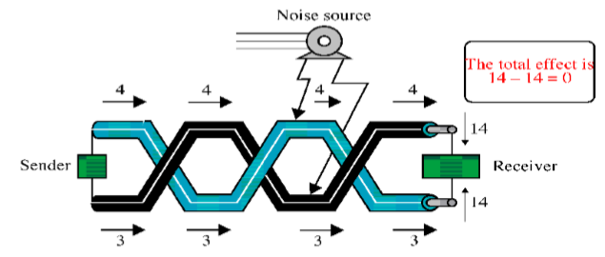
Twisted Pair cable
If the pair of wires are not twisted, electromagnetic noises from, e.g., motors, will affect the closer wire more than the further one, thereby causing errors. Therefore, cables are twisted to provide protection against crosstalk

Slide 46
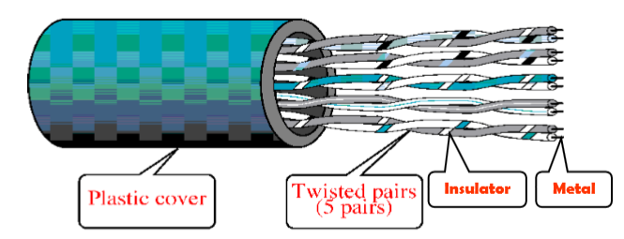
Unshielded twisted pair
Typically wrapped inside a plastic cover (for mechanical protection)
A sample UTP cable with 5 unshielded twisted pairs of wires

Slide 47
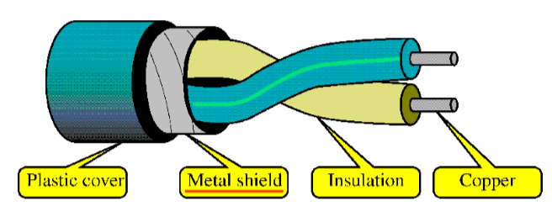
Shielded Twisted Pair (STP)
STP cables are similar to UTP cables, except there is a metal foil or braided-metal-mesh cover that encases each pair of insulated wires

Slide 48
Advantages of Twisted Pair Cable
It is of low cost
It is small in size
It is easy to install
It is the most popular and generally the best for schools.
disadvantages
It is subject to interference
It transmits at a limited distance, usually less than 100 meters.

Slide 49
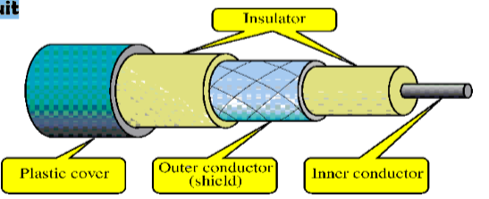
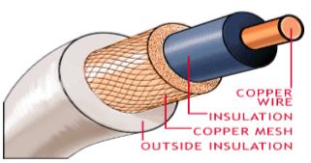
Coaxial cable
In general, coaxial cables, or coax, carry signals of higher frequency (100KHz–500MHz) than UTP cables
Outer metallic wrapping serves both as a shield against noise and as the second conductor that completes the circuit
Cable TV wiring uses coaxial cable because it can be cabled over longer distances than twisted-pair cable.

Slide 50
Coaxial cable
advantages
It highly resistant to signal interference. This is because it is heavily insulated than twisted-pair cable.
It is used for longer distances (300 – 600 meters)
It transmits faster than UTP.
disadvantages
It is heavy and bulky
It needs booster over long distances.

Slide 51
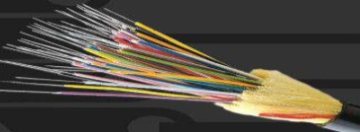
Fiber-Optic Cables
It is made up of strands (optic fibers) as thin as a human hair. Each optical fibre is surrounded by an insulating glass cladding and a protective coating.
Fiber optic cable are used by local and long distance telephone companies, cable TV and in high traffic networks or as the main cable in a network.

Slide 52
Fiber optic cable
Advantages
Carry significantly more signals than other cables.
They are faster in transmitting data.
They are less vulnerable to electrical noise from other devices.
They have better security for signals during transmission.
They smaller in size, much thinner and lighter than other cables.
Disadvantages
They are expensive as compared to other media
They are harder to install and modify.

Slide 53
Unguided media
These transport digital communications without cables between communication devices.
The media used in wireless transmission include; broadcast radio, cellular radio, microwaves, communication satellites, infrared and Bluetooth.
Wireless transmission is more convenient than installing cables but it has slower data transfer than hard-wired methods and it is also subject to interference

Slide 54
Microwave
These are high frequency radio waves that are sent through the atmosphere and space to deliver telecommunications services, including TV distributions.
Advantage
It is fast
Microwave signals can carry thousands of channels at the same time.
disadvantage
It uses line-of-sight only. That is, there is need for radio transmitters in networks using air interface to be positioned free of obstacle.

Slide 55
Satellite
This is a microwave station placed in outer space. A satellite receives a signal from the earth, amplifies it and then rebroadcasts it at a different frequency to any number of earth based stations.
Advantage
Always in sight
Disadvantage
It is expensive in terms of uplink and downlink facilities.

Slide 56
Infrared and Bluetooth
infrared uses Infrared Data Association (IrDA) ports to transmit data via infrared light waves. This only works if the communicating devices are within a few feet and nothing obstructs the path of the infrared light wave.
Bluetooth technology uses radio waves to transmit data between two devices.
Devices that use Bluetooth technology include, computers, smart phones, PDAs, cars, and other electronics. These contain a small chip that allows them to communicate with other Bluetooth-enabled devices.

Slide 57
Cable termination.
Cable Termination is the connection of the wire or fiber to a device, such as equipment, panels or a wall outlet, which allows for connecting the cable to other cables or devices.
Terminating cables involves the process of connecting the ends of a cable to connectors or devices to establish a functional link within a network. The termination process is crucial for ensuring proper connectivity and reliable data transmission.
The steps for terminating cables may vary depending on the type of cable (e.g., twisted pair, coaxial, fiber optic) and the connectors used.

Slide 58
Cable Termination Twisted Pair Cable (Ethernet Cables)
Tools (Requirements)
Twisted pair cable.
RJ45 connectors. It attaches to the twisted pair cable to enable connection to network devices.
Crimping tool. It is used to attach connectors to the ends of twisted pair cables.
Cable stripper. It is used to strip the outer jacket from the twisted pair cable.
Cable tester. It verifies that the cable is correctly terminated and is capable of carrying data.

Slide 59
Twisted Pair (Ethernet) cable
Steps
Strip about 1-1.5 inches (2.54-3.81 cm) of the outer jacket from the cable using a cable stripper.
Untwist and straighten the pairs of wires.
Arrange the wires according to the desired color code (T568A or T568B).
Insert the wires into an RJ45 connector, ensuring they reach the end of the connector.
Use a crimping tool to crimp the connector onto the cable securely.
Repeat the process for the other end of the cable.
Use a cable tester to verify that the cable is properly terminated.

Slide 60
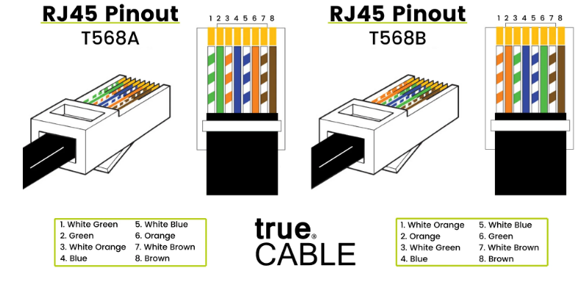
Ethernet Cable
a
Notes:
RJ-11 is used in telephone lines, it has four wires inside and it is smaller than RJ-45.
T568A is designed for backward compatibility with older telephone lines while T568B is designed for better signal isolation and noise protection for newer networking systems and products.
10Base5 is 10Mhz Ethernet running over standard thick 50Ohm baseband coaxial cable.
10BaseT is 10MHz Ethernet running over unshielded, twisted-pair cabling.

Slide 61
Ethernet cables.
Ethernet cables are a common type of twisted pair cables used to connect devices in local area networks (LANs) and provide wired network connectivity. They are part of the Ethernet standard, which is a widely used networking protocol.
Cable categories.
Ethernet cables come in different categories, each designed to meet specific performance standards. These are:
Cat5e (Category 5e). Supports data rates up to 1 gigabit per second (Gbps) at 100 MHz. Commonly used for fast Ethernet (10/100) and gigabit Ethernet (1000).
Cat6 (Category 6): Supports data rates up to 10 Gbps at 250 MHz. Suitable for 10/100/1000 Ethernet and 10-gigabit Ethernet.
Cat6a (Category 6a): Augmented Cat6 with enhanced performance. Supports data rates up to 10 Gbps at 500 MHz. Provides better performance and reduced crosstalk.
Cat7 (Category 7): Shielded twisted pair (STP) cable. Supports data rates up to 10 Gbps at 600 MHz. Enhanced shielding for reduced electromagnetic interference.
Cat8 (Category 8): Supports data rates up to 25/40 Gbps at 2000 MHz. Designed for high-performance data center applications.

Slide 62
Advantages of Ethernet Cables
They are used for connecting computers, printers, and other devices within a local network.
They are used for connecting computers, routers, and modems to provide internet access.
They are used to interconnect servers, switches, and other networking equipment in data center environments.
They are used for connecting devices such as smart TVs, gaming consoles, and streaming devices.
They are used for providing wired connectivity in office environments.

Slide 63
Disadvantages of Ethernet cables
Cable length limitations. Ethernet cables have maximum length limitations. Beyond certain distances, signal degradation may occur.
Interference. Electromagnetic interference (EMI) can affect performance. Shielded cables (STP) provide better protection against interference.
Poor-quality connectors or improper termination can lead to connectivity issues.
Higher category cables generally provide better performance. Using a cable with a higher category than required can future-proof the network.
Avoid excessive bending or kinking of cables, as this can damage the internal wires and impact performance.

Slide 64
Coaxial cable
Tools (Requirements)
Coaxial cable
Coaxial connectors (e.g., F-type connectors). Attaches to the coaxial cable, allowing it to be connected to devices.
Coaxial cable stripper. It is used to strip the outer jacket and expose the inner conductor of coaxial cables.
Coaxial crimping tool. It attaches connectors to the ends of coaxial cables.

Slide 65
Coaxial Cable
Steps
Strip about 1 inch (2.54 cm) of the outer jacket from the coaxial cable using a coaxial cable stripper.
Expose the inner conductor and insulator.
Slide the coaxial connector over the exposed conductor.
Crimp the connector onto the cable using a coaxial crimping tool.
Repeat the process for the other end of the cable.
Use appropriate adapters to connect the terminated coaxial cable to devices.

Slide 66
Fibre Optic Cable
Tools (Requirements)
Fiber optic cable
Fiber optic connectors (e.g., SC, LC, ST). It attaches to the end of the fiber optic cable, facilitating connection to network devices.
Fiber optic cleaver. It is used to cleave (cut) optical fibers cleanly for termination.
Epoxy and curing oven (for epoxy connectors). It is used in the termination process for certain types of fiber optic connectors.
Fusion splicer (for fusion-splice connectors). It is used for permanent fusion splicing of optical fibers.

Slide 67
Fibre Optic Cable
Steps
Strip the protective coating from the fiber optic cable using precision stripping tools.
Clean and cleave the optical fibers.
Attach the fiber optic connectors using epoxy or fusion splicing, following the manufacturer's guidelines.
Cure the epoxy connectors in a curing oven if epoxy is used.
Polish the connectors to ensure a smooth and efficient optical interface.
Repeat the process for the other end of the cable.
Use proper inspection tools to verify the quality of the fiber optic termination.

Slide 68
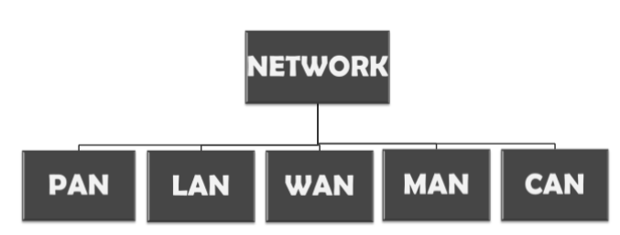
CLASSIFICATION OF NETWORKS BY THEIR GEOGRAPHY

Slide 69
LOCAL AREA NETWORK(LAN)
LAN is a network which is designed to operate over a small physical area such as an office, factory or a group of buildings. Different types of topologies such as star, tree, bus, ring, etc. Can be used
It is usually a privately owned network.
Advantages
LAN’s are easy to design and troubleshoot
LANs typically offer high data transfer rates within a confined geographical area.
Devices on a LAN can share resources such as printers, files, and applications.
LANs are cost-effective for small to medium-sized networks.
Low latency and high performance are achievable within a limited area.
Disadvantages:
LANs are limited to a specific geographical area, making them unsuitable for connecting geographically dispersed locations.
The initial setup costs and maintenance of LAN infrastructure can be relatively high.

Slide 70
WIDE AREA NETWORK
When network spans over a large distance or when the computers to be connected to each other are at widely separated locations a local area network cannot be used. A wide area network(WAN) is installed.
The communication between different users of WAN is established using leased telephone lines, satellite links and similar channels.
Advantages
WANs can connect devices across large distances, making them suitable for connecting remote locations.
Similar to LANs, WANs enable resource sharing across wide geographic areas.
Centralized management of resources and data is possible.
Disadvantages:
WANs often involve higher costs for infrastructure, equipment, and connectivity.
Data transfer rates may be slower compared to LANs due to the extended distances.
Securing data over long distances can be more challenging.
Note
However LAN is more secure than WAN.

Slide 71
PERSONAL AREA NETWORK(PAN)
A personal area network is a computer network organized around an individual person. It generally consists of a mobile computer, a cell phone or personal digital assistant. PAN enables the communication among these devices.
Advantages:
PAN devices often have low power consumption, making them suitable for personal devices.
PANs are highly portable and are typically associated with personal devices like smartphones, laptops, and wearable technology.
Disadvantages:
PANs have a limited range, usually within a person's immediate vicinity.
Data transfer rates may not be as high as in larger networks.
Notes:
It can also be used for communication among personal devices themselves for connecting to a digital level network and internet.
The PANs can be constructed using wireless or cables.

Slide 72
CAMPUS AREA NETWORK(CAN)
The campus area network is made up of an interconnection of LAN with limited geographical area. Network equipment such as switches, routers and the transmission media i.e. optical fibre etc. are almost entirely owned by the campus owner.
Advantages:
CANs can be scaled to cover large campus environments with multiple buildings.
Similar to LANs, CANs facilitate resource sharing within a campus.
Disadvantages:
Installation Complexity: Building a CAN may involve complex installation and maintenance processes.
Costs: Costs associated with the deployment of a CAN can be significant.

Slide 73
METROPOLITAN AREA NETWORK(MAN)
It is in between LAN & WAN technology that covers the entire city. It uses similar technology as LAN.
Advantages
MANs provide a balance between LANs and WANs, offering moderate data transfer rates over a city-sized area.
MANs are more cost-effective than WANs for regional networking.
Like LANs, MANs support resource sharing within a city or metropolitan area.
Disadvantages
Limited Scalability: MANs may face scalability challenges when trying to cover larger regions.
Security Concerns: Security challenges may arise when extending network connectivity across a larger area.
Notes:
It can be a single network such as cable TV network, or a measure of connecting a number of LAN’s o a large network so that resources can be shared LAN to LAN as well as device to device.

Slide 74
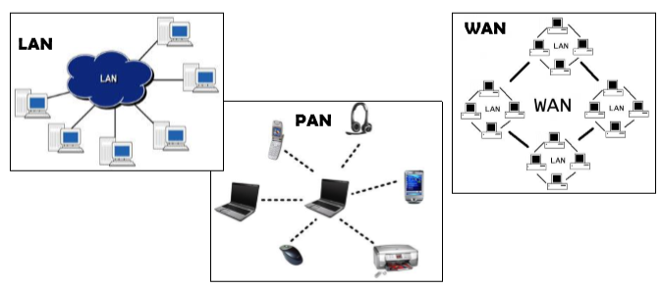

Slide 75
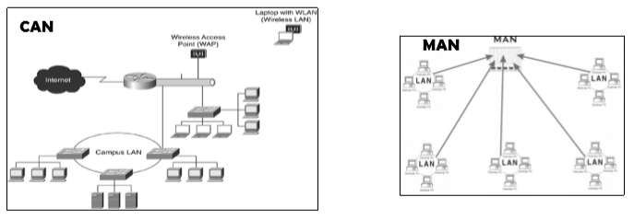

Slide 76
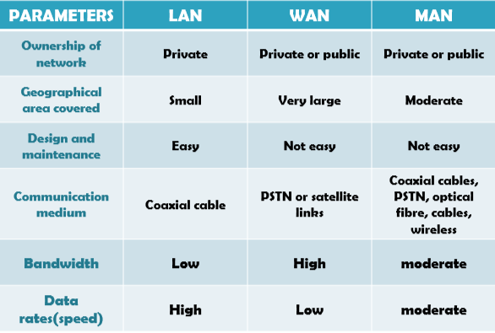
Comparison of LAN, WAN, MAN

Slide 77
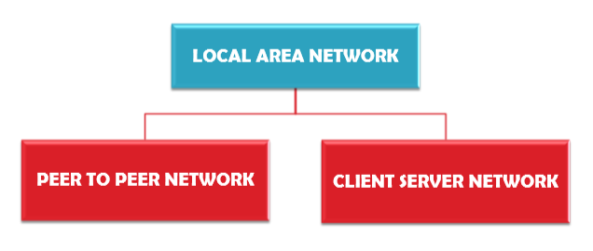
NETWORK CLASSIFICATION BY THEIR COMPONENT ROLE

Slide 78
Peer to Peer network
In peer to peer network each computer is responsible for making its own resources available to other computers on the network.
Each computer is responsible for setting up and maintaining its own security for these resources.
Also each computer is responsible for accessing the required network resources from peer to peer relationships.
Peer to peer network is useful for a small network containing less than 10 computers on a single LAN .
In peer to peer network each computer can function as both client and server.
Peer to peer networks do not have a central control system. There are no servers in peer networks.
Peer networks are amplified into home group.

Slide 79
ADVANTAGESOF PEER TO PEER NETWORK
Uses less expensive computer hardware
Easy to administer
More built in redundancies
Easy setup & low cost
Disadvantages:
Not very secure
No central point of storage or file archiving
Additional load on computer because of resource sharing
Hard to maintain version control
Notes:
No NOS required

Slide 80
CLIENT/SERVER NETWORK
In client-server network relationships, certain computers act as server and other act as clients. A server is simply a computer that is available on the network resources and provides service to other computers when they request it. A client is the computer running a program that requests the service from a server.
Local area network(LAN) is based on client server network relationship.
A client-server network is one n which all available network resources such as files, directories, applications and shared devices, are centrally managed and hosted and then are accessed by client.
Client server network are defined by the presence of servers on a network that provide security and administration of the network.

Slide 81
ADVANTAGES OF CLIENT-SERVER NETWORK
Very secure
Better performance
Centralized backup
very reliable
Disadvantages:
Requires professional administration
More hardware intensive
More software intensive
Expensive dedicated software is needed.

Slide 82
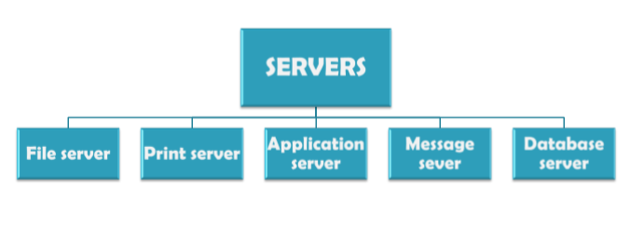
Types of servers.

Slide 83
TYPES OF SERVERS
File server: These servers provide the services for storing, retrieving and moving the data. A user can read, write, exchange and manage the files with the help of file servers.
Printer server: The printer server is used for controlling and managing printing on the network. It also offers the fax service to the network users.
Application server: The expensive software and additional computing power can be shared by the computers in a network with he help of application servers.
Message server: It is used to co-ordinate the interaction between users, documents and applications. The data can be used in the for of audio, video, binary, text or graphics.
Database server: It is a type of application server. It allows the uses to access the centralized strong database.

Slide 84
INTERNET, INTRANET AND EXTRANET
Internet:
The network formed by the co-operative interconnection of a large number of computer networks.
Network of Networks
No one owns the Internet
Every person who makes a connection owns a slice of the Internet.
There is no central administration of the Internet.

Slide 85
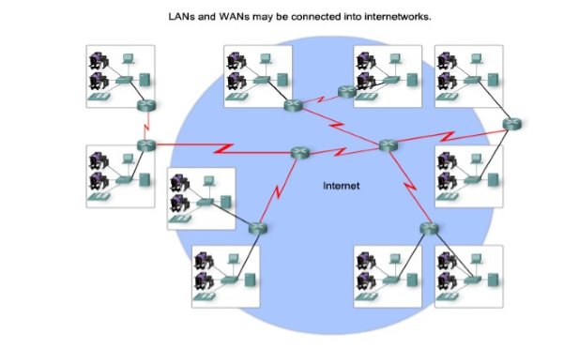
Internet

Slide 86
Internet
Internet is comprises of :
A community of people who use and develop the network.
A collection of resources that can be reached from those networks.
A setup to facilitate collaboration among the members of the research and educational communities world wide. The connected networks use the TCP/IP protocols:
important Internet applications:
world wide web(WWW)
File Transfer Protocol(FTP)
Electronic Mail
Internet Relay Chat

Slide 87
Intranet
An intranet is a private network within an organization that is used for internal communication, collaboration, and information sharing. It typically utilizes internet technologies and protocols but is restricted to authorized users within the organization. Intranets serve as a centralized hub for employees to access company resources, documents, and communication tools.
Advantages:
Intranets serve as a centralized platform for internal communication, fostering collaboration among employees.
Intranets allow organizations to share documents, policies, and important information across different departments.
Intranets reduce the need for physical documentation and streamline processes, leading to cost savings.
Improved access to information and resources contributes to increased employee productivity.

Slide 88
Extranet
Disadvantages:
Initial setup costs, including infrastructure and development, can be substantial.
Regular maintenance and updates are necessary to keep the intranet secure and functional.
Some employees may resist using the intranet, requiring training and change management efforts.
Intranets need robust security measures to protect sensitive internal information.

Slide 89
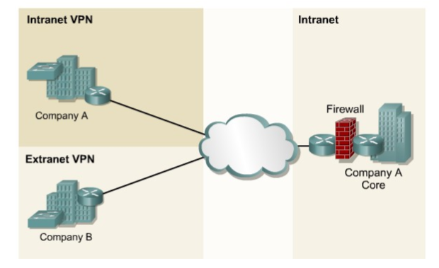

Slide 90
Extranet
An extranet is a private network that extends beyond an organization's internal network and allows controlled access to specific external users, such as customers, suppliers, or business partners. It combines elements of both the internet and intranet, providing a secure platform for collaborative activities and information sharing between an organization and its external stakeholders.
Advantages
Extranets facilitate collaboration and communication between an organization and its external partners, such as suppliers, vendors, and clients.
Access to the extranet is typically controlled through authentication and authorization, ensuring secure communication.
Extranets enable the sharing of specific resources, documents, and information with external stakeholders.
Extranets provide a cost-effective means of communication and collaboration compared to traditional methods like face-to-face meetings.

Slide 91
Extranets
Disadvantages
Despite authentication measures, security remains a concern, especially when dealing with sensitive information.
Setting up and maintaining an extranet can be complex, requiring careful planning and security measures.
Reliability is dependent on the stability and security of external networks, which may not always be under the organization's control.

Slide 92
Mobile Ad Hoc Network (MANET)
A Mobile Ad Hoc Network (MANET) is a decentralized type of wireless network where nodes (devices) communicate with each other directly or through other nodes in their proximity. MANETs are dynamic and self-configuring, making them suitable for scenarios where a fixed infrastructure is unavailable or impractical. Examples include military applications, emergency response situations, and collaborative efforts in areas with limited infrastructure.
Advantages:
MANETs are highly flexible and can be set up quickly without relying on fixed infrastructure.
Ideal for emergency scenarios or situations where the establishment of a fixed infrastructure is not feasible.
MANETs operate without a centralized control, allowing for increased autonomy among nodes.
MANETs can be more cost-efficient in certain scenarios compared to deploying fixed infrastructure.

Slide 93
MANET
Disadvantages:
The lack of a centralized authority makes MANETs vulnerable to security threats such as attacks and unauthorized access.
Scalability can be a challenge as the network size increases, and the efficiency of routing algorithms may decrease.
Constant changes in the network's topology due to node mobility can impact network performance and reliability.
Mobile devices in MANETs may have limited power and processing capabilities, affecting overall network efficiency.

Slide 94
NETWORK ANALOGIES
Analogies and layouts are often used to explain the structure and functionality of different types of networks.
Highway System Analogy: Compares a network to a highway system where data (vehicles) travels between different locations (cities). The roads (communication lines) connect cities (devices), and data (vehicles) moves efficiently.
Postal System Analogy: Relates a network to a postal system where information (letters/packages) is sent and received. Data packets are like letters, routers/switches are post offices, and delivery routes represent communication paths.
Social Network Analogy: Compares a network to a social network where people (devices) are connected through relationships (communication links). Devices communicate and share information much like people in a social network.

Slide 95
NETWORK ANALOGIES
Centralized Office Analogy: Equates a network to a centralized office where employees (devices) communicate through a central hub (server). The central hub serves as a focal point for communication and resource sharing.
Library Catalog Analogy: Relates a network to a library catalog where resources (data) are organized and accessed through a centralized system. Devices access and retrieve information from a central repository.

